Slide 1
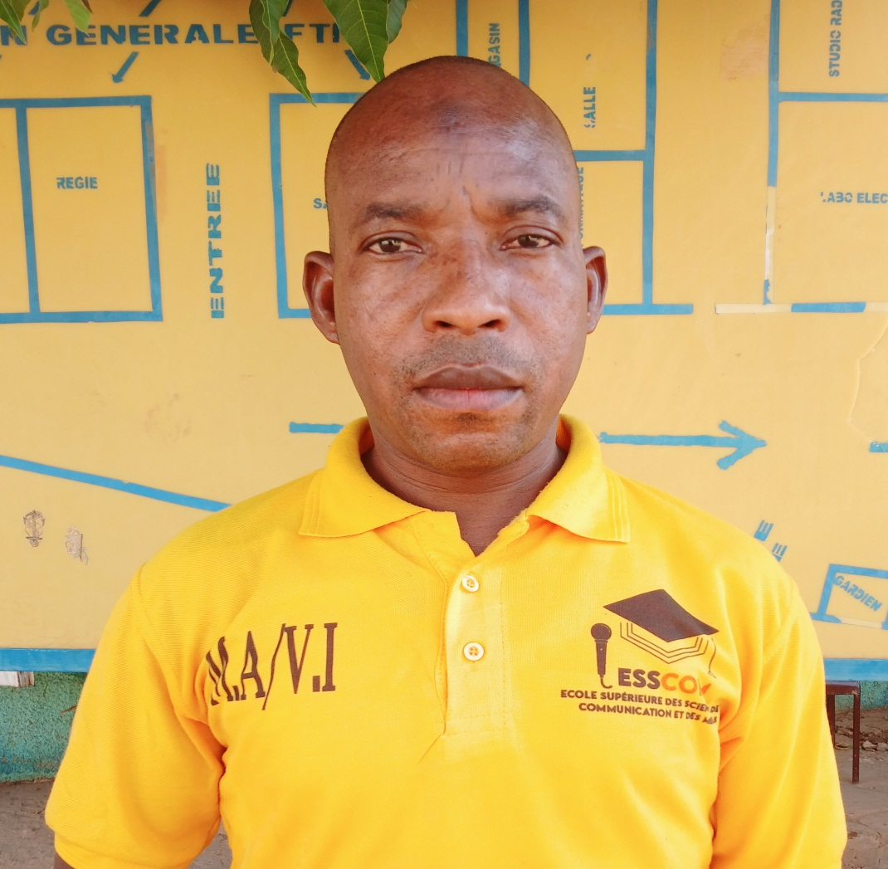
MY JOURNALISM JOURNEY
ABDOU SEYNI : ST ABDOU Seyni April 29th 2025

Slide 2
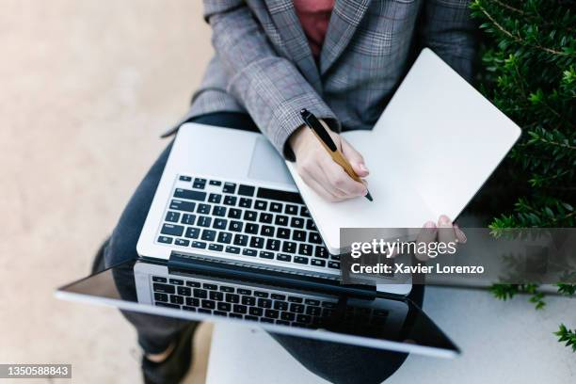
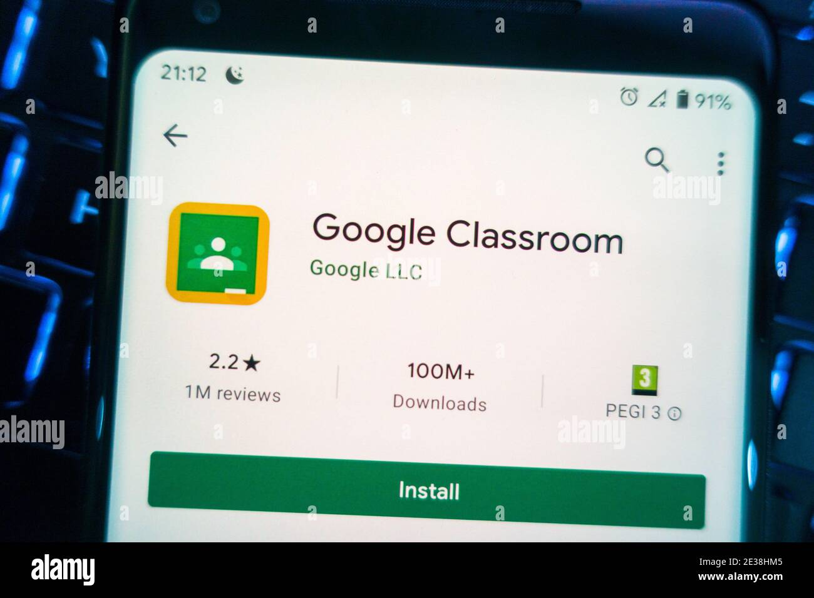
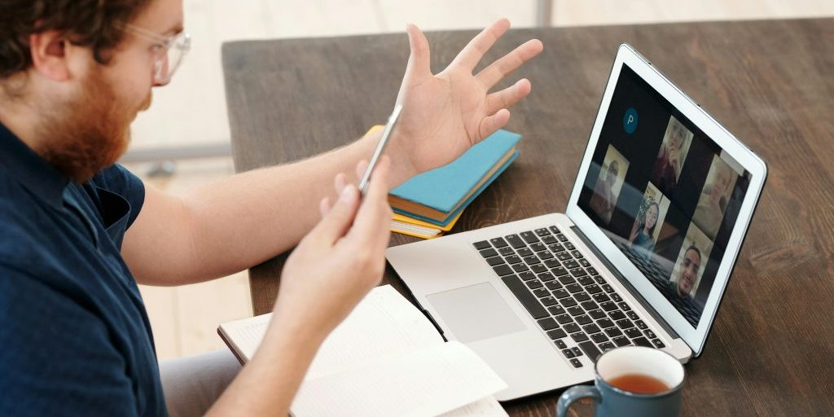
THREE MAIN IMPORTANT POINTS THAT I LEARNED
Principles of journalism | How to use google classroom | How to do an investigative story
A journalist must use his own words for telling his story and need to tell the whole story ,not a part of it. A journalist must make his process clear to the reader and writes accurately an article without bias. | I understood how to use this very handy app that was new to me. This form of communication also allowed me to post my homework and receive notifications digitally. | I I retained how to ask the questions and who to interview in oder to have reliable informations for writing an article. What kinds of informations are used to write an article. The topics chosen must be of importance to our community.

Slide 3
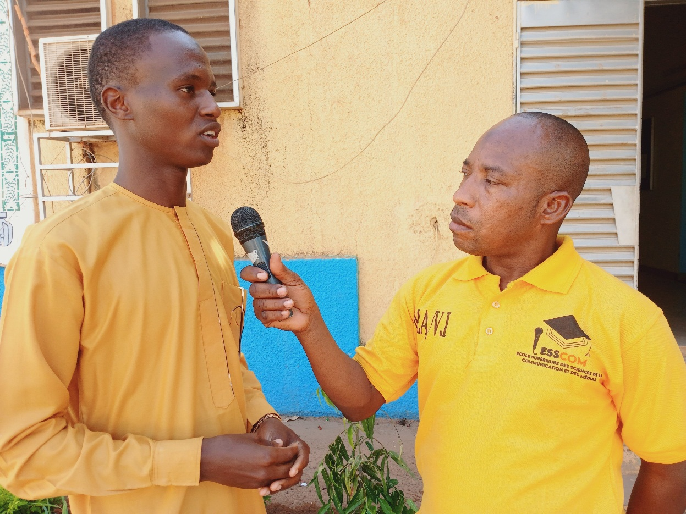
Professional benefits
This training provide me benefits for my career as a futur journalist,such as:
-improved writing skills,namely mastery of journalistic writing and interview and investigative techniques;
-networking opportunities;
-knowledge of the legal and ethical framework.
This course gave me the confidence to express my ideas clearly.

Slide 4

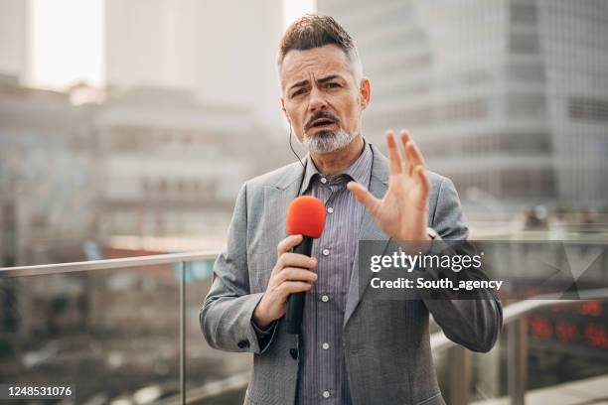
CONCEPTS TO DEVELOP
If the training is offered again,I would like to go further:
Data journalism
To train me in analysis tools
Live reporting
To transmit immédiate,authentic and lively information to the public

Slide 5
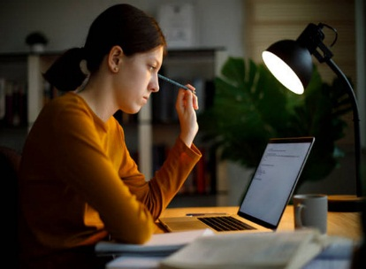
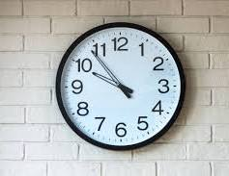
MOST DIFFICULT ASPECTS
Those that seem a little difficult to me at the beginning of the course:
It’s the accent of the language,since it was new to me
The tight deadlines
But as the saying goes,<< little by little,the bird builds its nest >>,and as the course progressed,I began to get used to it.The tight deadlines taught me how to manage my timebetter.

Slide 6
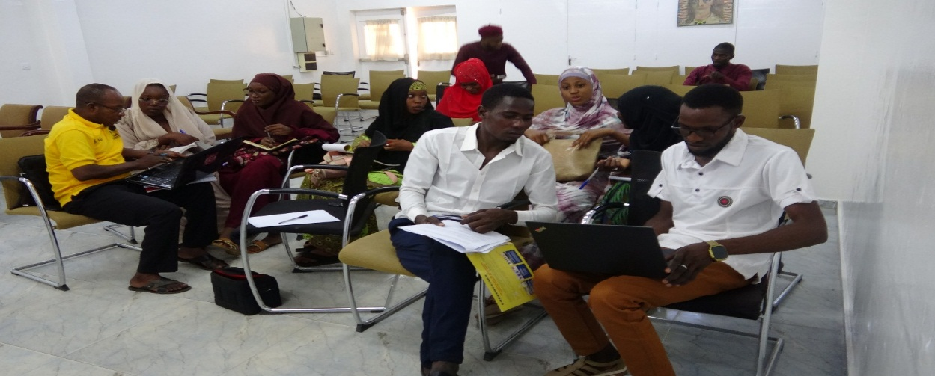
TO CLOSE
This course has transformed me into a more competent and curious journalist,who is eager to learn more.
Professeur TAHIRA MOHAMED ,Mr KADER and all the management staff ,a huge thank you for your boldness at our side!Thanks to your energy and your commitment, we push the limits of what is possible every day.I also thank my classmates with I followed this training.This is ony the beginning:To gahter we will continue to aim hight, dream big and above all accomplish the extraordinary.Let’s remain bold.

